Slide 1
Without modern medical intervention, how many times would you have died by now?

Slide 2
Communicating Research with Effective Storytelling
AFS2024 Workshop - Day 2
Megumi Oshima & Pavel Dimens

Slide 3
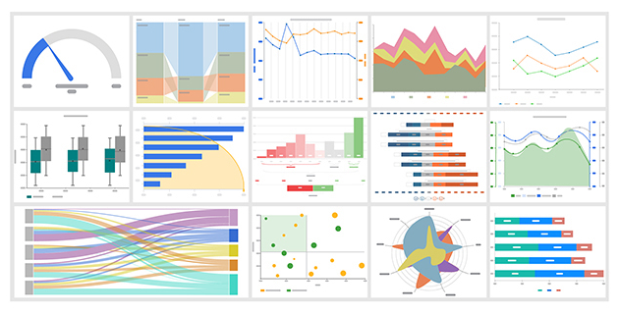
Information
facts
facts, but pictures

Slide 4
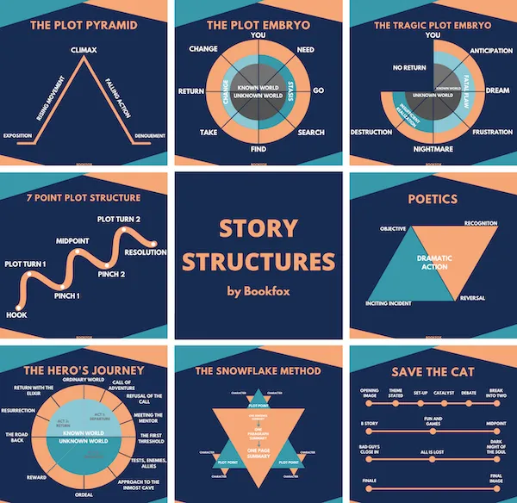
Story
introduction
setting
characters
direction
conflict to resolve

Slide 5
Story about information
introduction
setting
characters
direction
conflict to resolve
where are we
what are we doing
what are we looking at
It’s just worldbuilding ground us

Slide 6
Story
introduction
setting
characters
direction
conflict to resolve
why are you bothering
why should we care
convince us this is cool or important

Slide 7
Story
introduction
setting
characters
direction
conflict to resolve
we need to go somewhere

Slide 8
Direction

Slide 9
Direction
The setup
The rationale
What you did
How it went
Ok cool, what now?
linear flow

Slide 10

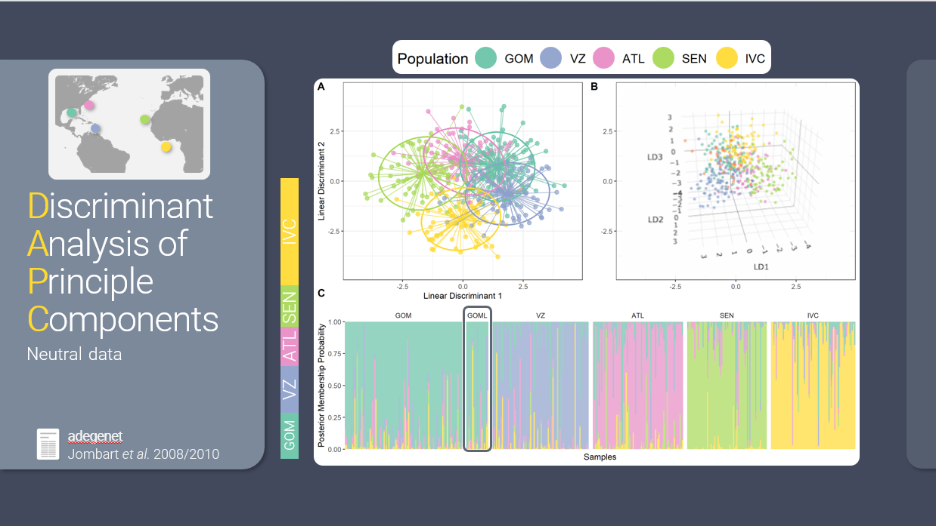
flow
visual
auditory

Slide 11
Exercise

Slide 12

floooooooooow
sound is a stream
sight is a shotgun

Slide 13
5 Minute Break

Slide 14

✨Aesthetics ✨
Keep an audience’s interest for technical topics
A chance to add some personality
Notes:
Less text
Slide Master
Insert Icons

Slide 15
Fonts
sans serif vs serif
Size
Mix n’ match for emphasis
Google Fonts
Notes:
Choose a sans serif font option over a serif
Make sure the font size (on everything) is large enough for an audience to read in a large room
Can have a main font and then use a different one for emphasis or accent
Resources like google fonts have a lot of different fonts you can download and use for free

Slide 16
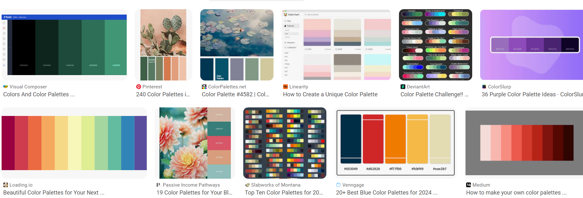
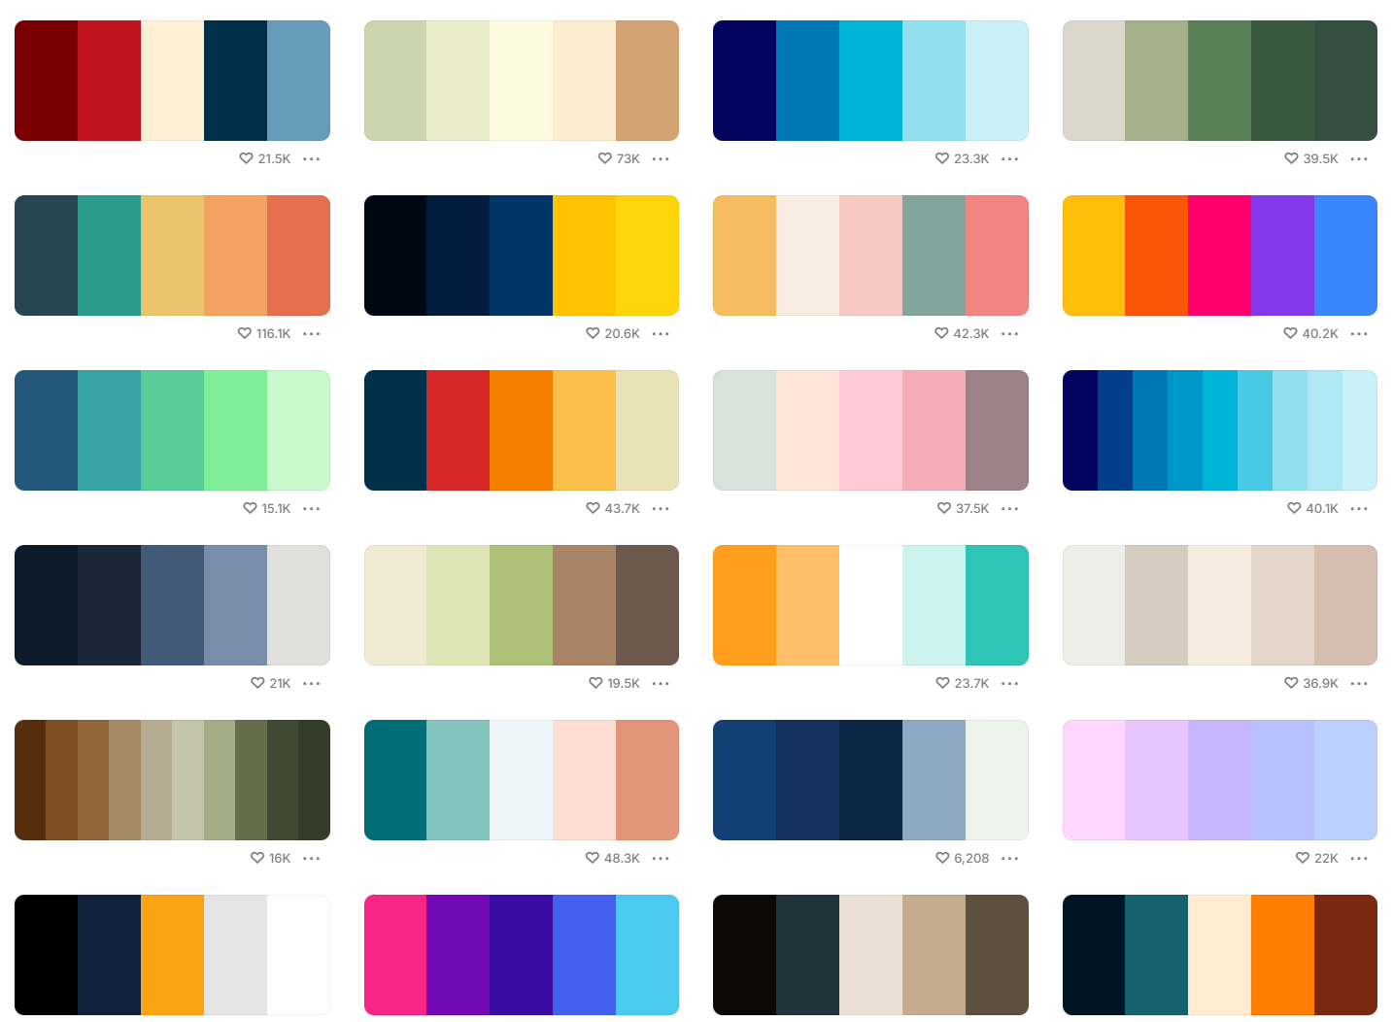
Colors
Consistent colors
Build cohesive color palettes
Look for inspiration or use a pre-made one
coolors
Notes:
Creating a color palette to use throughout your talk can give it a really nice cohesive feel. Powerpoint’s defaults have improved over time but to really make your presentation stand out, create your own. You want to make sure your color palette is pleasing (not all bright vivid colors that are harsh on the eyes and hard to see) and accessible. You can get inspiration from anything, just a quick google for color palette or use resources like coolors to find pre-made palettes or create your own.

Slide 17
Less text
These bullets are very wordy.
Each bullet is a full sentence.
test

Slide 18
Use icons

Slide 19
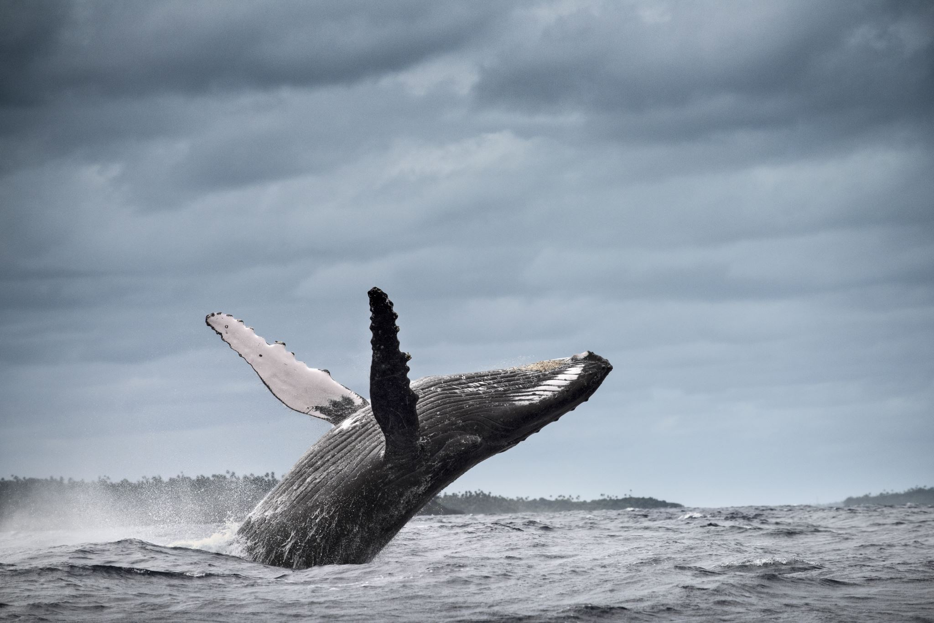
Make your images dimensional

Slide 20
Make your images dimensional
Rounded corners

Slide 21
Make your images dimensional
Rounded corners
Add a drop shadow

Slide 22
Make your images dimensional
Rounded corners
Add a drop shadow
Give it a background

Slide 23
Make your images dimensional
Rounded corners
Add a drop shadow
Give it a background
Change the shape

Slide 24
5 Minute Break

Slide 25
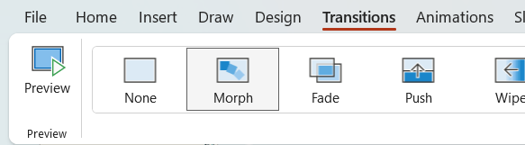
Behold: Morph

Slide 26
Topic Title

Slide 27
Topic Title

Slide 28
Second Topic

Slide 29
Third Topic

Slide 30
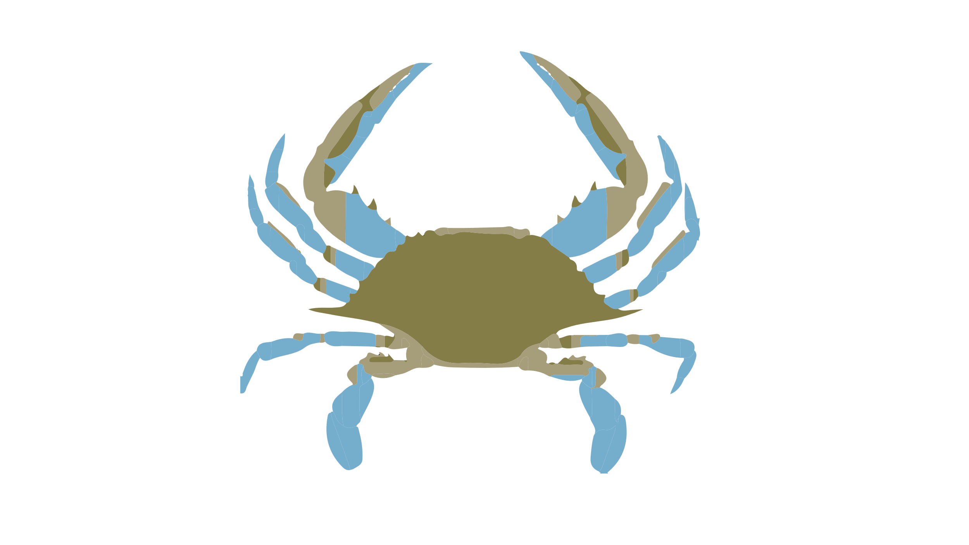
Here are facts
Is this big
Likes to do this
Likes to go here
Hates paprika
Nihilistic
Cyberbully

Slide 31
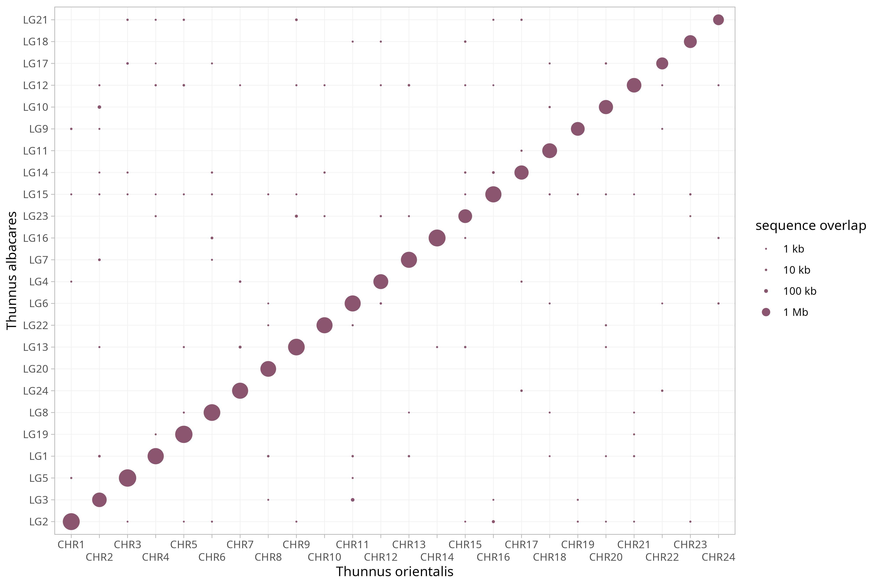
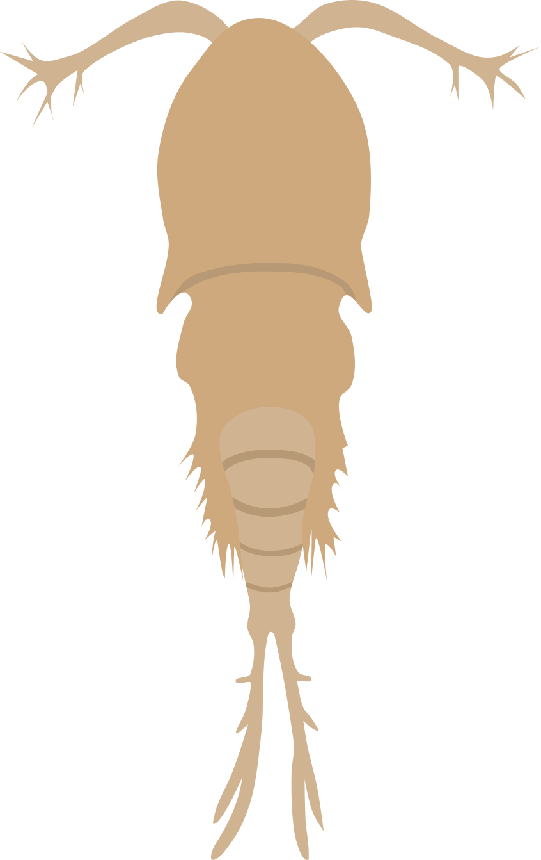
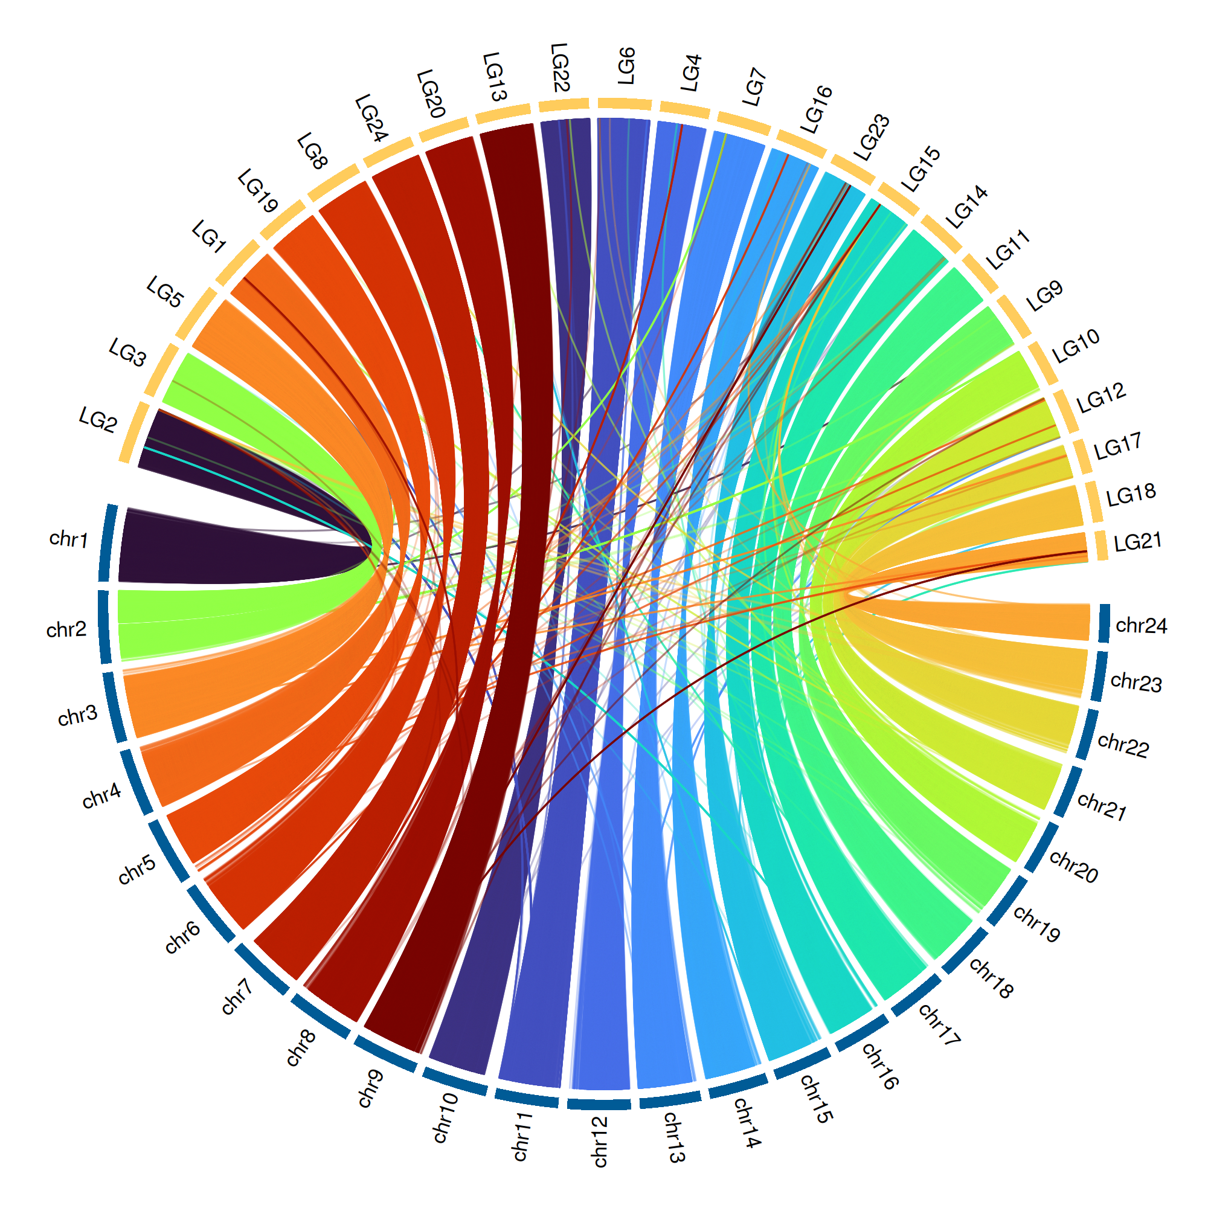
Is this big
Likes to do this
Likes to go here
Hates paprika
Nihilistic
Cyberbully

Slide 33

Appear

Slide 34
Appear

Slide 35

Appear

Slide 36
Appear

Slide 37

Push

Slide 38
Push

Slide 39
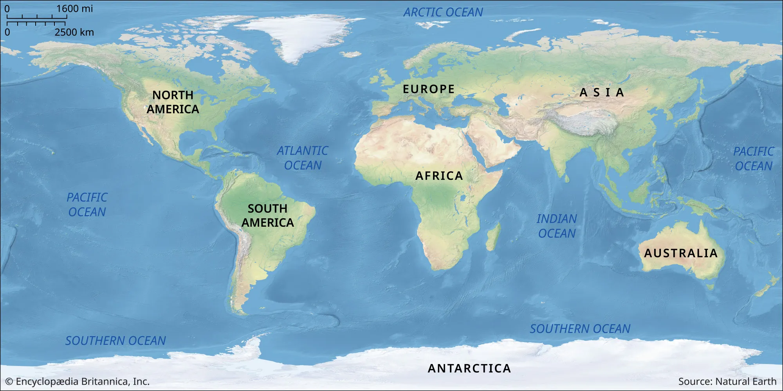
Image Pan

Slide 40
Image Pan

Slide 41
Image Pan

Slide 42
Image Pan

Slide 43
5 Minute Break

Slide 44
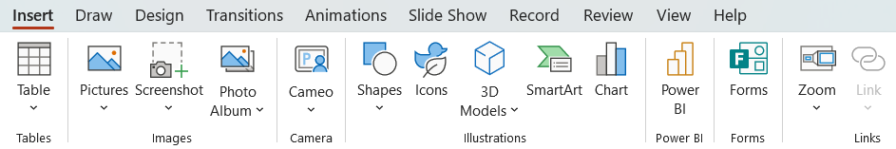
Zoom

Slide 45
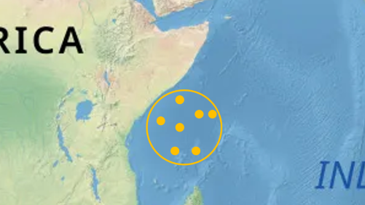
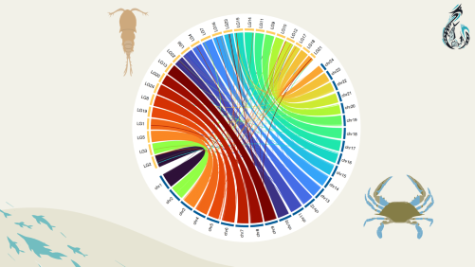
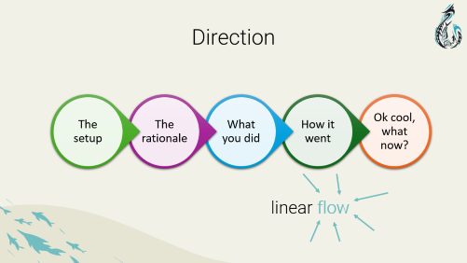



Zoom

Slide 46
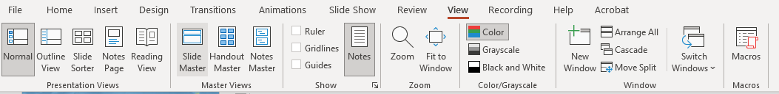
Slide Master

Slide 47
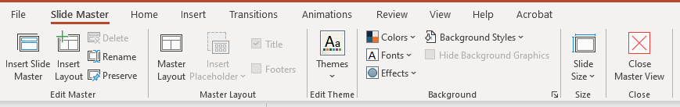
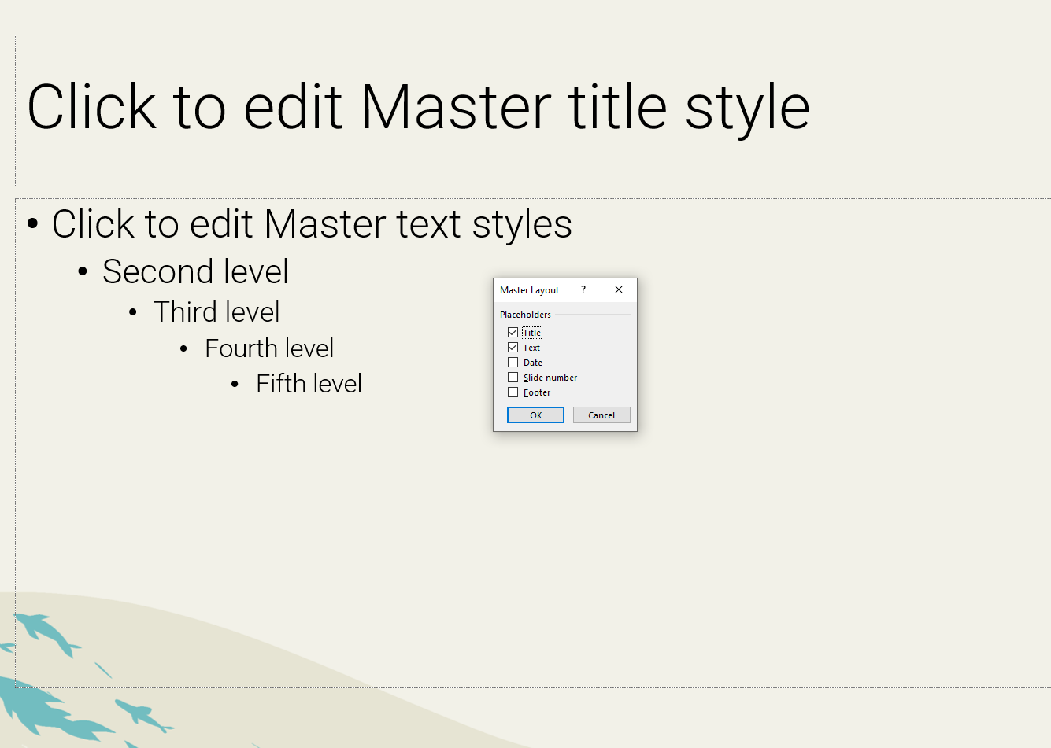

Slide 48
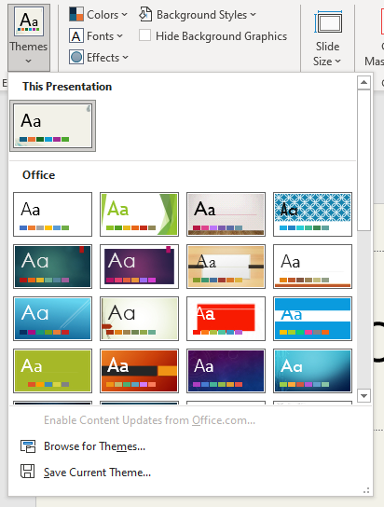
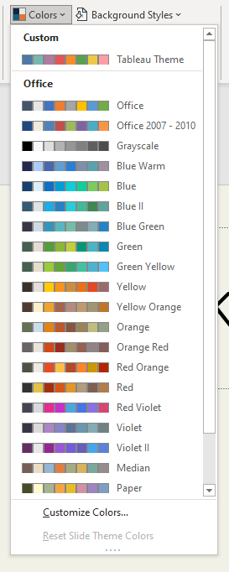
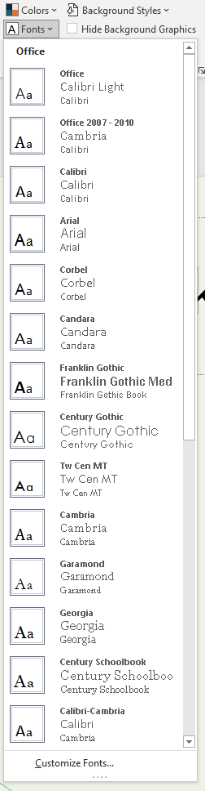

Slide 49
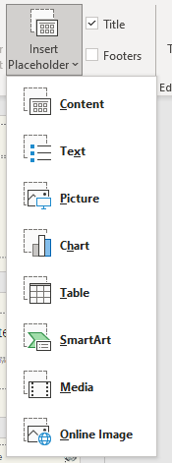
Title
Text
Chart
Chart

Slide 50
Important things are important

Slide 51
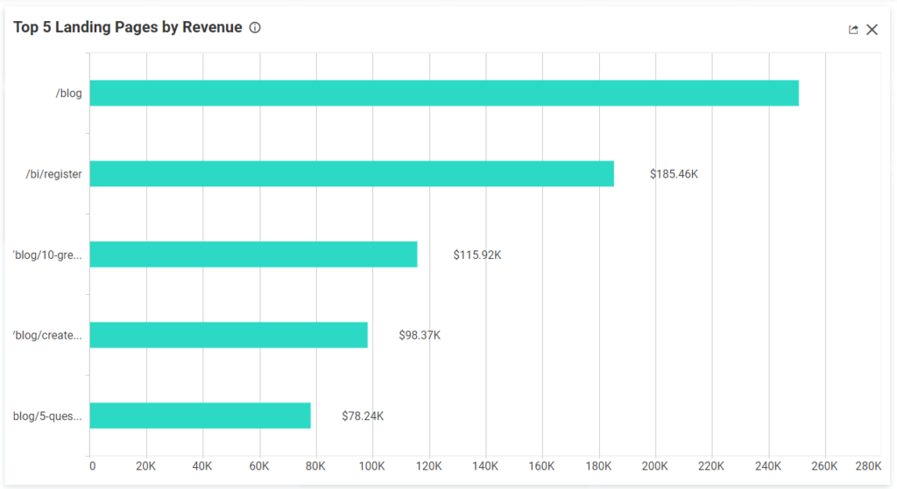
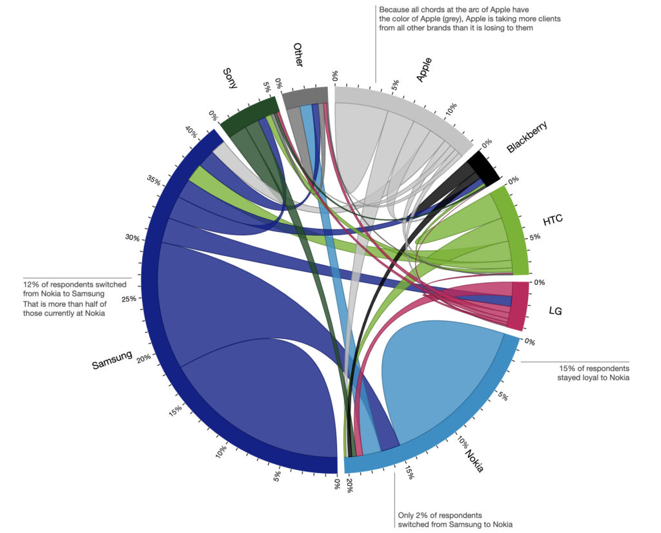
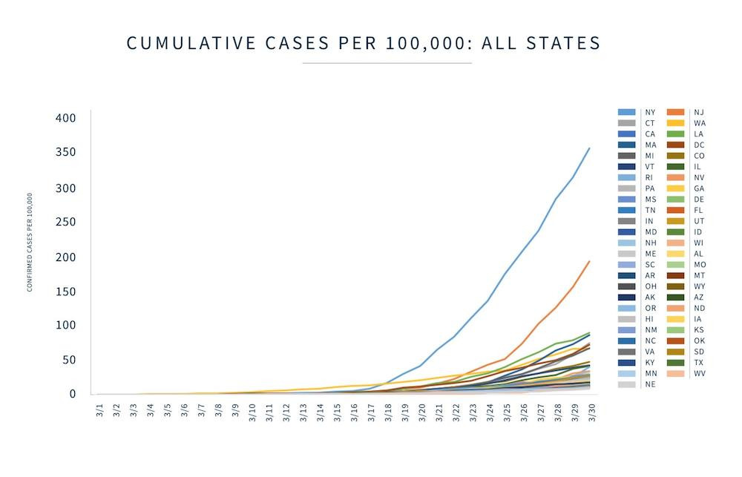
Title
some kind of text
more text about stuff

Slide 52
Title

Slide 53
Title

Slide 54
Title

Slide 55
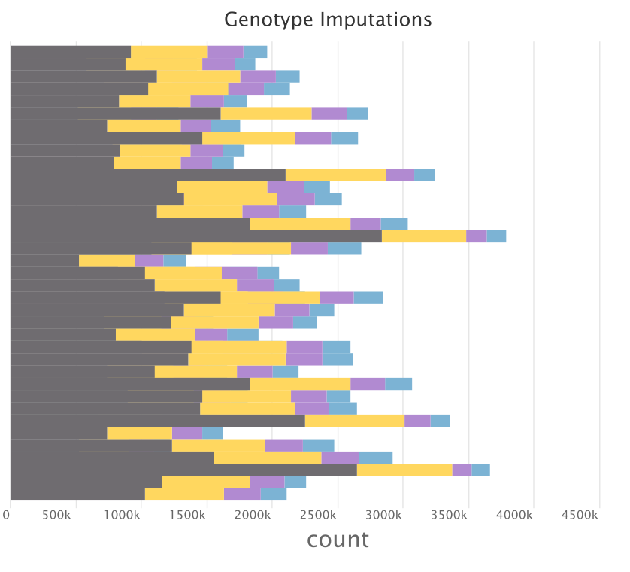
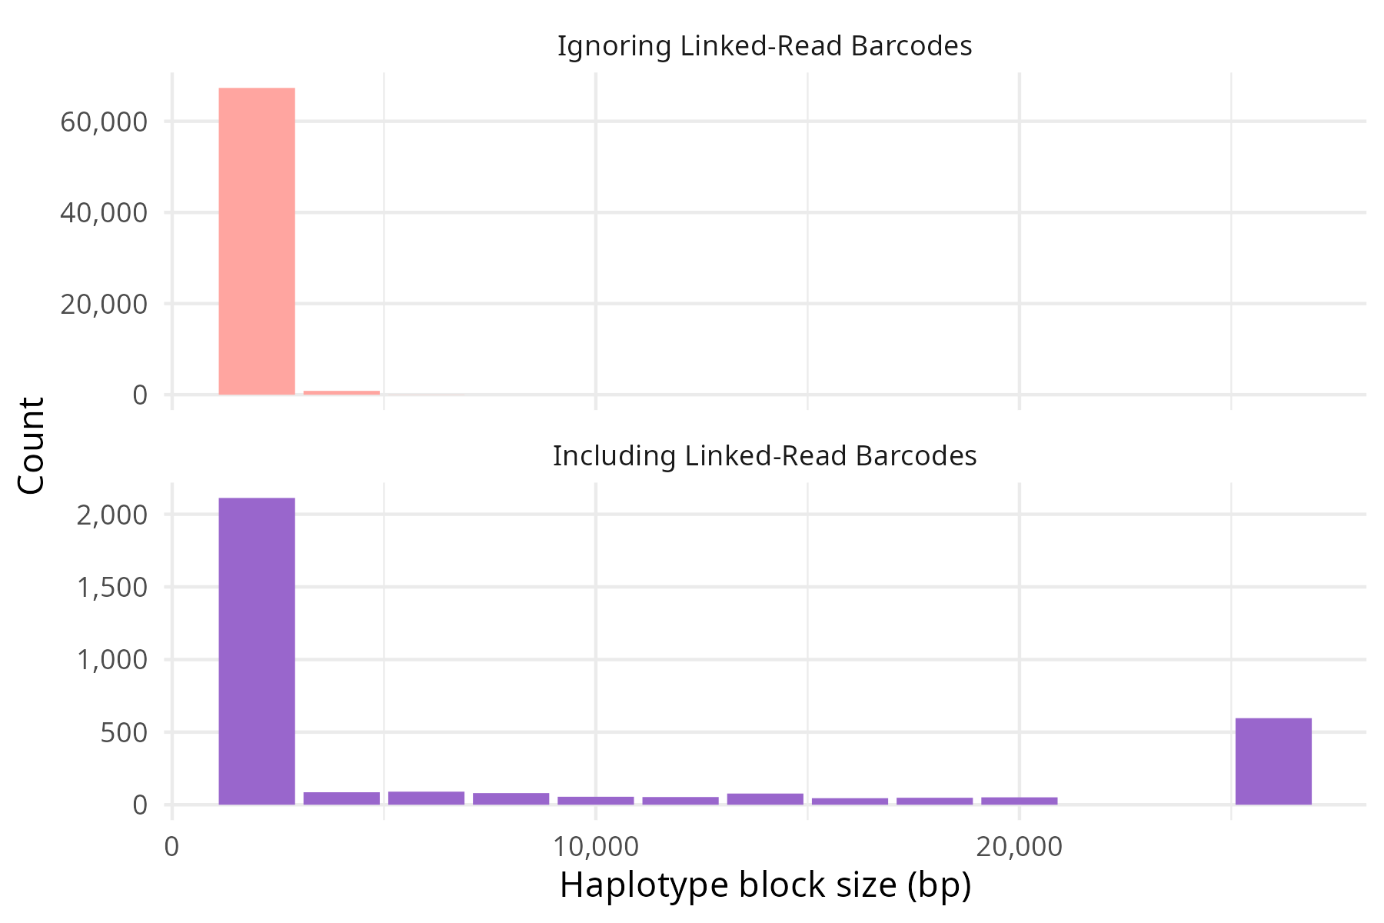
Recover many missing genotypes with linked-read aware imputation
Not Imputed
Hom Ref
Hom Alt
Het
called genotype
Phase SNPs into haplotypes
25kbp+

Slide 56

Recover many missing genotypes with linked-read aware imputation
Phase SNPs into haplotypes
25kbp+
Not Imputed
Hom Ref
Hom Alt
Het
called genotype

Slide 57
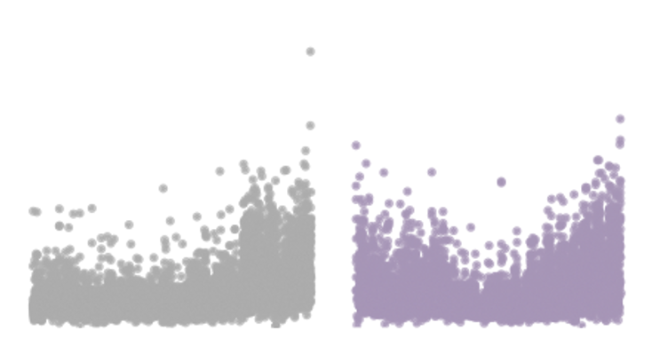
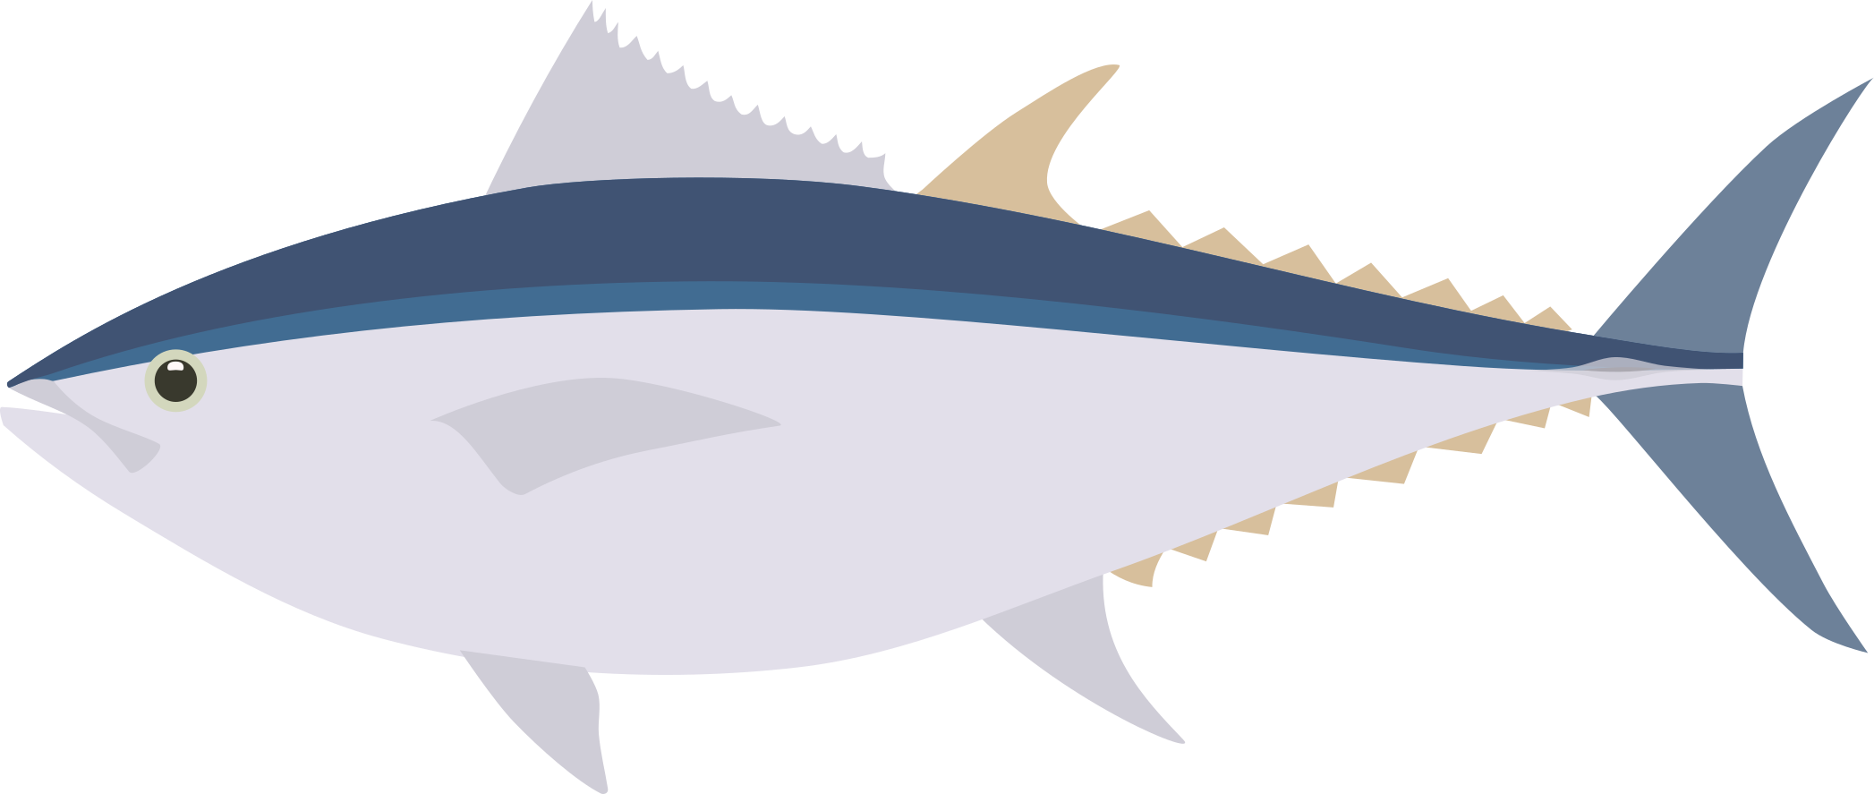

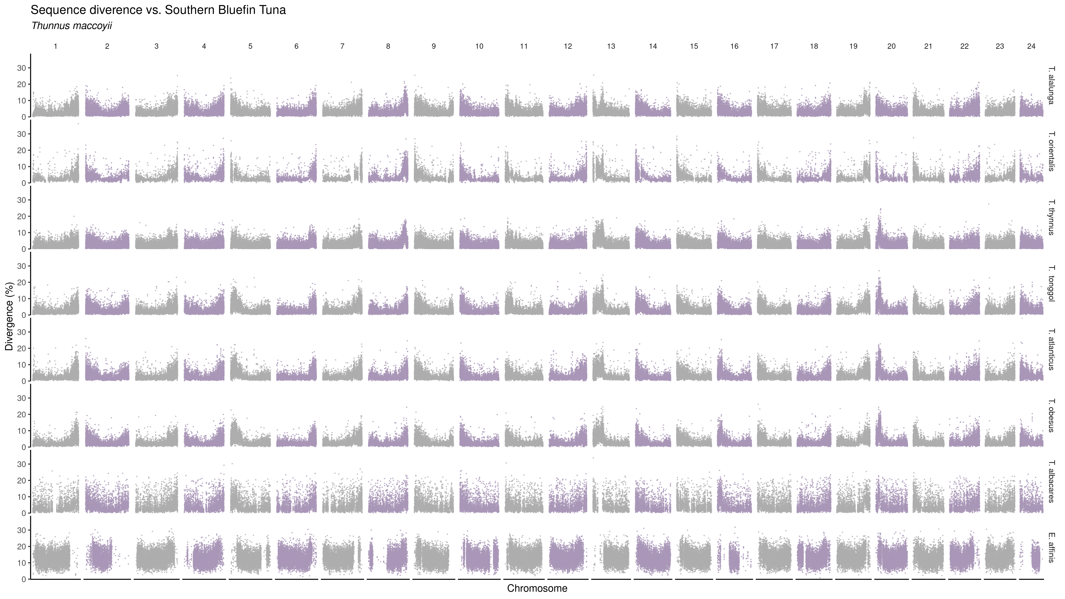
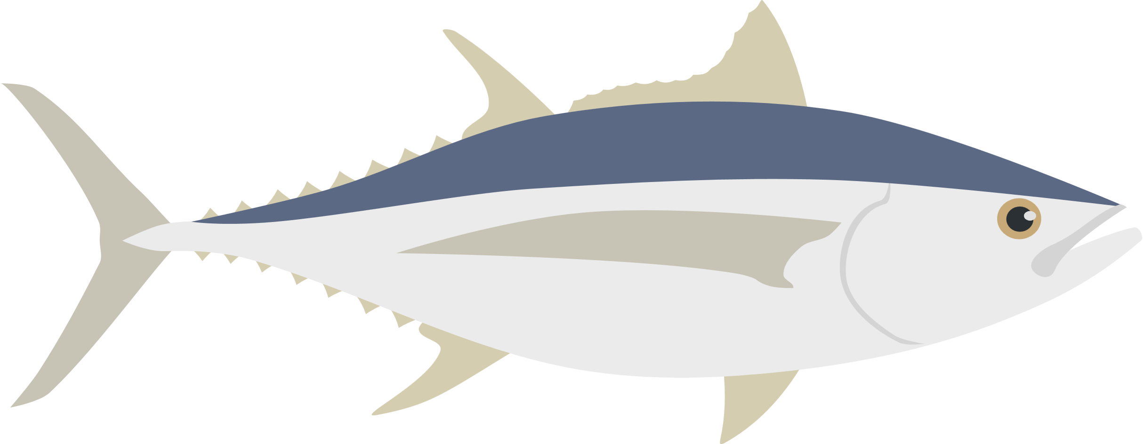

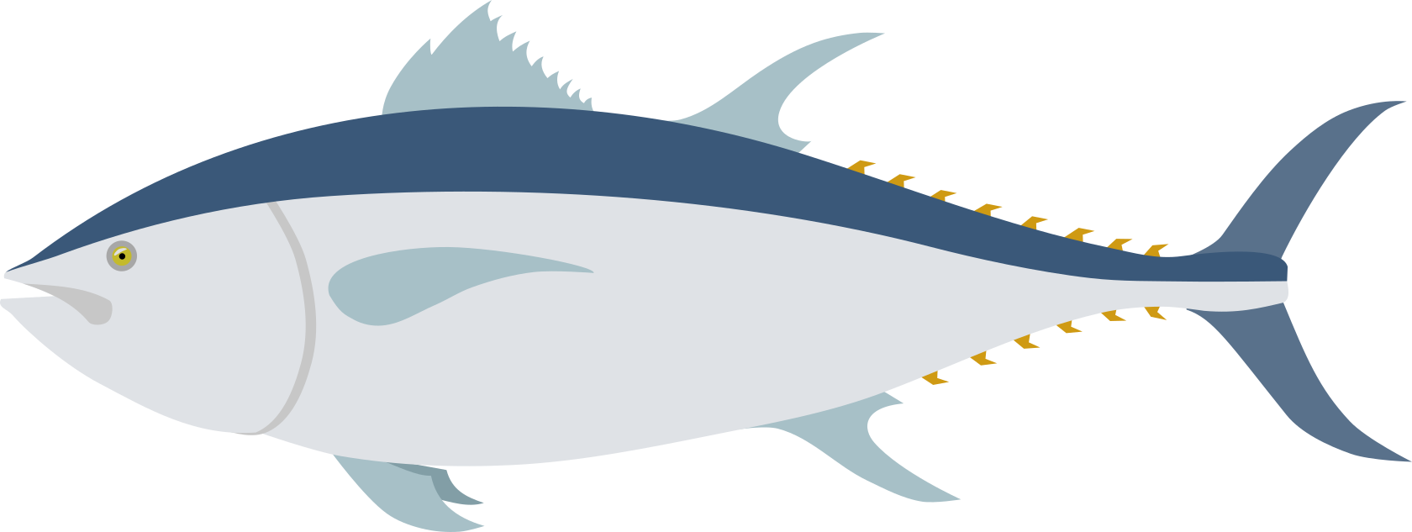
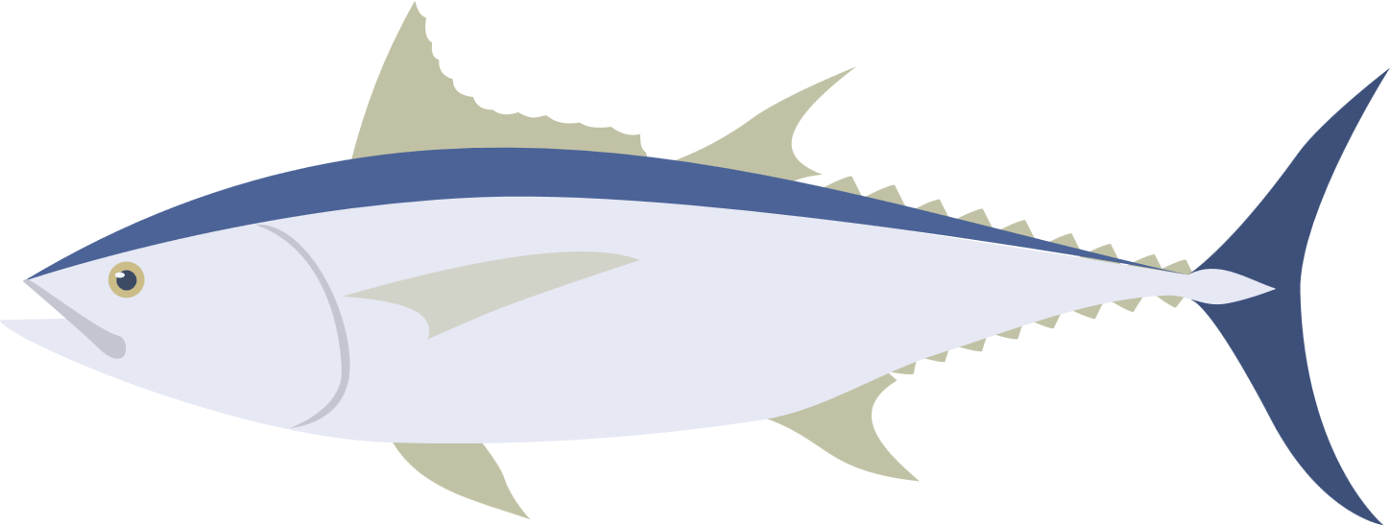

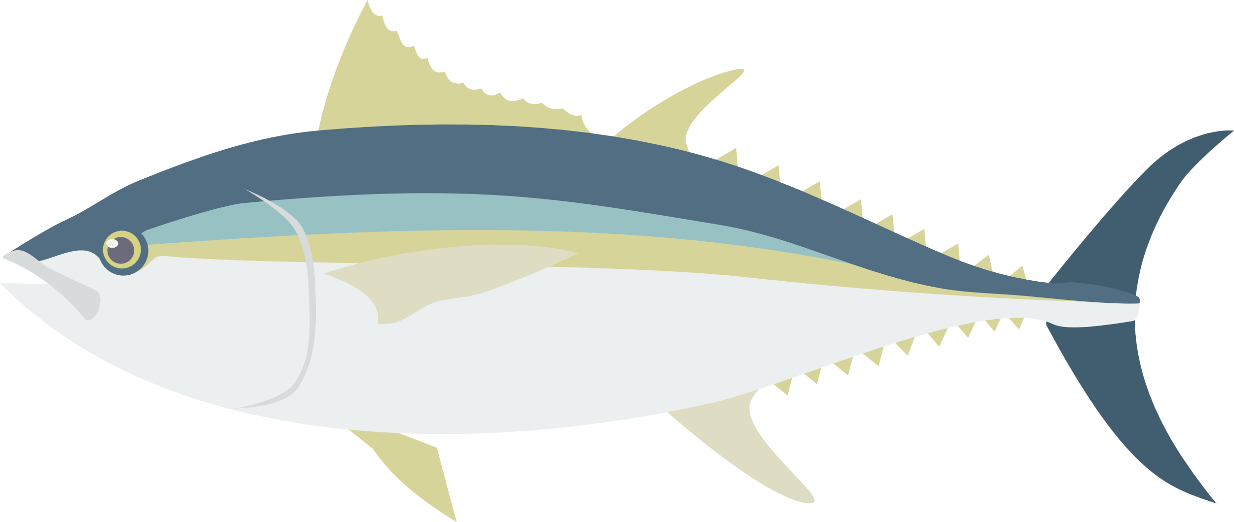

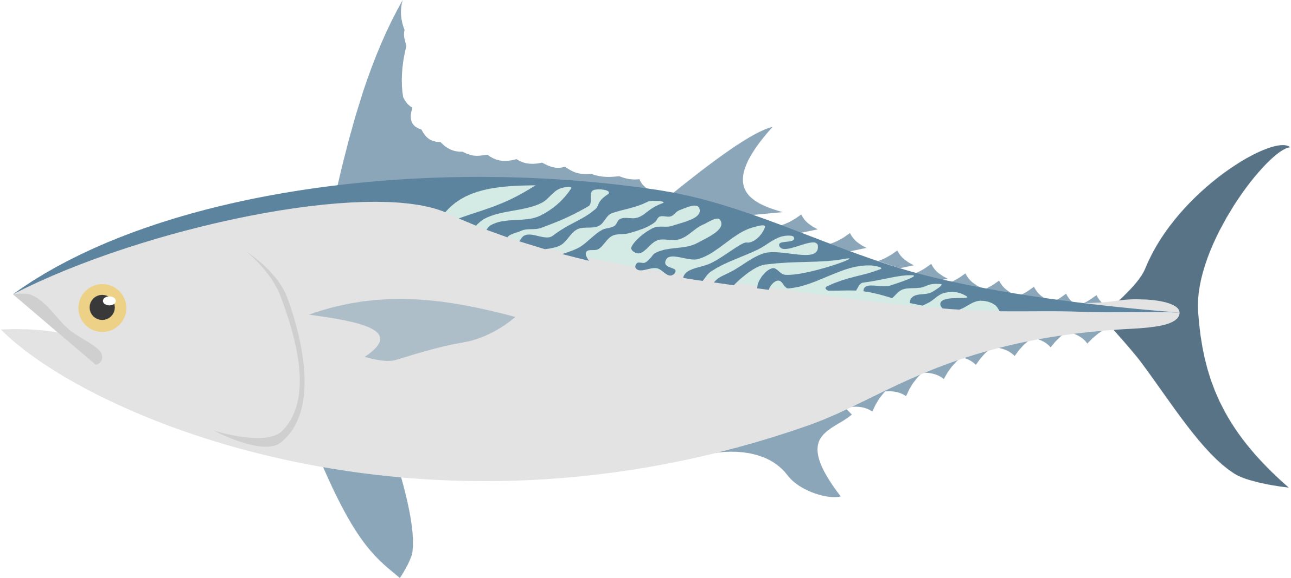
Sequence divergence vs Southern bluefin tuna
Marçaiset al. 2018
Notes:
relationship btwn species
conserved regions
confirm a tree

Slide 58
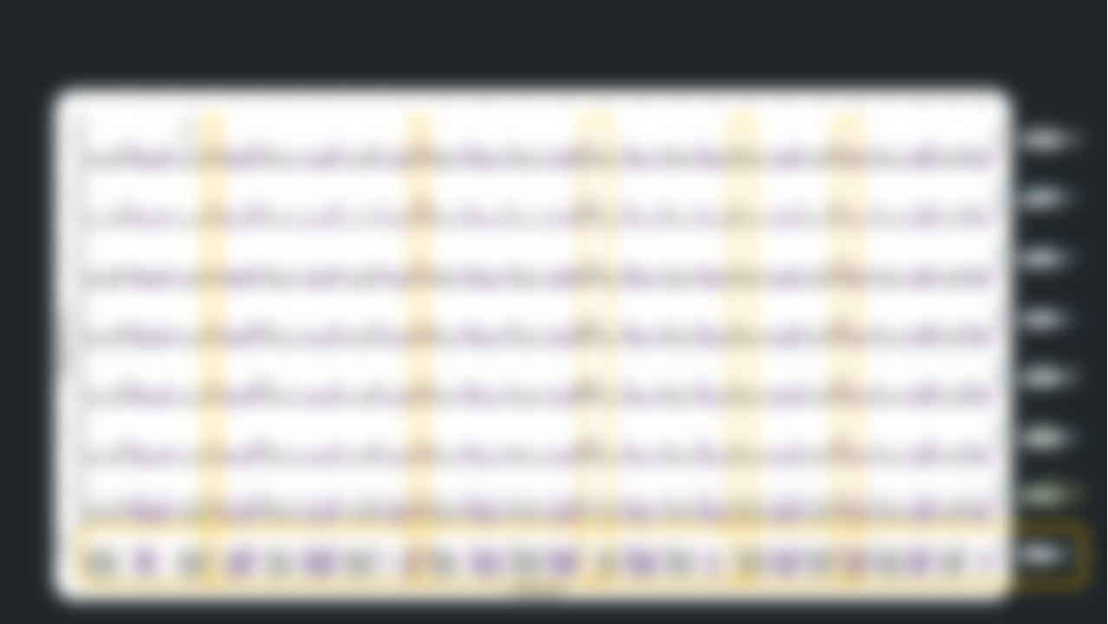
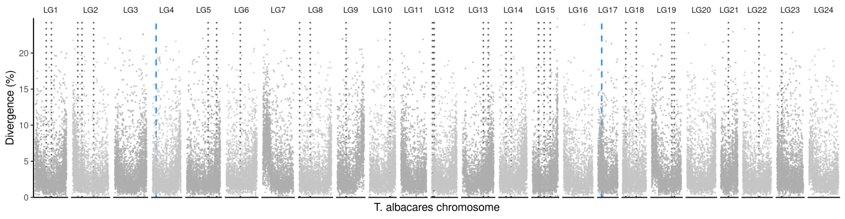




Sequence divergence vs Southern bluefin tuna
Sequence divergence between Yellowfin and Blackfin tuna
Marçaiset al. 2018
Yellowfin tuna
Blackfin tuna
Notes:
relationship btwn species
conserved regions
confirm a tree

Slide 59

Sequence divergence vs Southern bluefin tuna
Sequence divergence between Yellowfin and Blackfin tuna
Marçaiset al. 2018
Centromere?
Telomere?
Notes:
relationship btwn species
conserved regions
confirm a tree

Slide 60
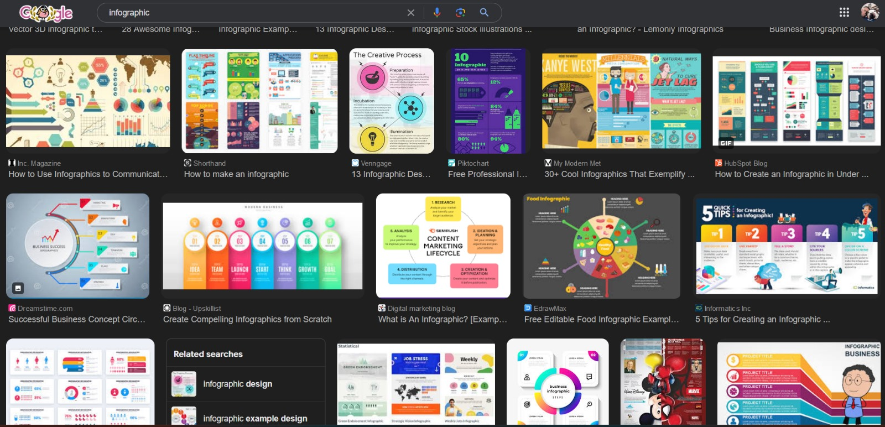
Look at what the pros are doing

Slide 61
5 Minute Break

Slide 62

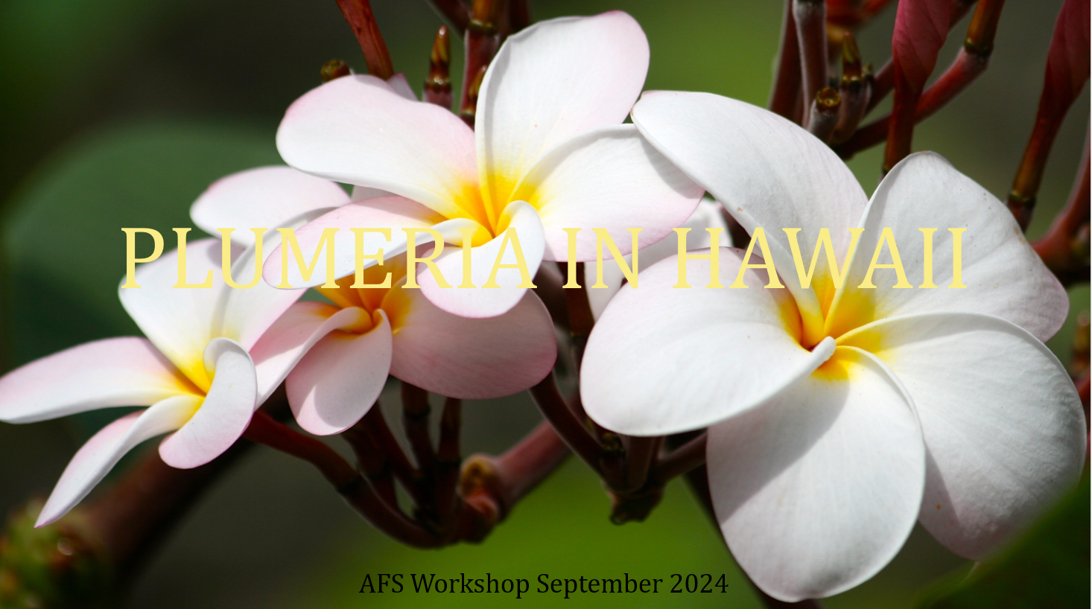

Group Project
Fix these terrible presentations

